Slide 1

CSCE 120/121 Introduction to Program Design & Concepts
Recursion
Dr. Tim McGuire
Grateful acknowledgment to Dr. Philip Ritchey and Dr. Michael Moore for some of the material on which these slides are based.

Slide 2
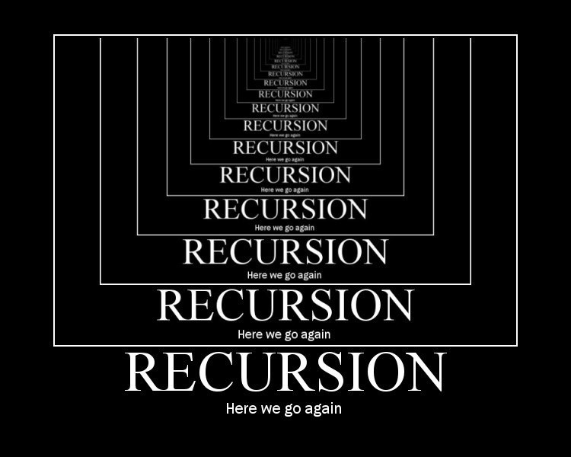

Slide 3


First, a Digression
Mathematicians and Telephones

Slide 4
n! = 1 if n = 0 n! = n*(n-1)! if n > 0
4! = 4 x 3! =
3! = 3 x 2! =
2! = 2 x 1! =
1! = 1 x 0! =
0! = ?
24
6
2
1
1

Slide 5
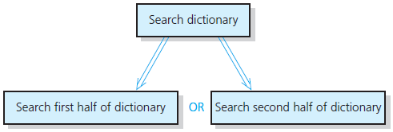
Recursive Solutions (1 of 3)
Recursion breaks problem into smaller identical problems
An alternative to iteration

Slide 6
Recursive Solutions (2 of 3)
A recursive function calls itself
Each recursive call solves an identical, but smaller, problem
Test for base case enables recursive calls to stop
Eventually, one of smaller problems must be the base case

Slide 7
Recursive Solutions (3 of 3)
Questions for constructing recursive solutions:
How to define the problem in terms of a smaller problem of same type?
How does each recursive call diminish the size of the problem?
What instance of problem can serve as base case?
As problem size diminishes, will you reach base case?

Slide 8
The Recursion Pattern
Classic example--the factorial function:
n! = 1· 2· 3· ··· · (n-1)· n
Recursive definition:
As a C++ function:
// recursive factorial function
int fact(int n)
{
if (n == 0) return 1; // base case
else return n * fact(n - 1); // recursive case
}

Slide 9
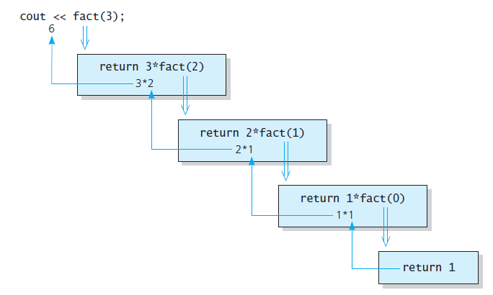
The Factorial of n
fact(3)
Source: Walls & Mirrors, by Carrano and Henry
Notes:
Run factorial program

Slide 10
Recursive Functions - Purpose
Recursive functions are used to reduce a complex problem to a simpler-to-solve problem.
The simpler-to-solve problem is known as the base case
Recursive calls stop when the base case is reached

Slide 11
Stopping the Recursion
A recursive function must always include a test to determine if another recursive call should be made, or if the recursion should stop with this call
In the factorial function, the test is:
if (n == 0)

Slide 12
Stopping the Recursion
Recursion uses a process of breaking a problem down into smaller problems until the problem can be solved
In the factorial function, a different value is passed to the function each time it is called
Eventually, the parameter reaches the value in the test, and the recursion stops

Slide 13
Challenges
What if you do not include a base case or get to the base case?
Infinite recursion (think of an infinite loop)
Each time the recursive call occurs, a new stack frame is created…
Eventually, you will run out of memory!
Stack Overflow

Slide 14
Rules for Good Recursive Function
One or more base cases
Always returns without further recursion
One or more recursive function calls
Must get closer to base case
Don‘t forget to use the result of your recursive call!

Slide 15
Types of Recursion
Direct
a function calls itself
Indirect
function A calls function B, and function B calls function A
function A calls function B, which calls …, which calls function A

Slide 16
Recursion Memory Diagram
CSCE 121
Notes:
3:00 class starts here

Slide 17
Output
void rPrint(int n) {
if (n<=0) {
return;
}
cout << n << endl;
rPrint(n-1);
}
int main() {
int n = 1;
do {
cout << "Enter Number: ";
cin >> n;
cout << "Start Printing" << endl;
rPrint(n);
cout << "End Printing" << endl;
} while (n>0);
}
Enter Number:
3
Start Printing
1
main
n
3
Identifier
Stack

Slide 18
Output
void rPrint(int n) {
if (n<=0) {
return;
}
cout << n << endl;
rPrint(n-1);
}
int main() {
int n = 1;
do {
cout << "Enter Number: ";
cin >> n;
cout << "Start Printing" << endl;
rPrint(n);
cout << "End Printing" << endl;
} while (n>0);
}
Enter Number:
3
Start Printing
3
rPrint
n
3
main
n
3
Identifier
Stack

Slide 19
Output
void rPrint(int n) {
if (n<=0) {
return;
}
cout << n << endl;
rPrint(n-1);
}
int main() {
int n = 1;
do {
cout << "Enter Number: ";
cin >> n;
cout << "Start Printing" << endl;
rPrint(n);
cout << "End Printing" << endl;
} while (n>0);
}
Enter Number:
3
Start Printing
3
2
rPrint
n
2
rPrint
n
3
main
n
3
Identifier
Stack

Slide 20
Output
void rPrint(int n) {
if (n<=0) {
return;
}
cout << n << endl;
rPrint(n-1);
}
int main() {
int n = 1;
do {
cout << "Enter Number: ";
cin >> n;
cout << "Start Printing" << endl;
rPrint(n);
cout << "End Printing" << endl;
} while (n>0);
}
Enter Number:
3
Start Printing
3
2
1
rPrint
n
1
rPrint
n
2
rPrint
n
3
main
n
3
Identifier
Stack

Slide 21
Output
void rPrint(int n) {
if (n<=0) {
return;
}
cout << n << endl;
rPrint(n-1);
}
int main() {
int n = 1;
do {
cout << "Enter Number: ";
cin >> n;
cout << "Start Printing" << endl;
rPrint(n);
cout << "End Printing" << endl;
} while (n>0);
}
Enter Number:
3
Start Printing
3
2
1
rPrint
n
1
rPrint
n
2
rPrint
n
3
main
n
3
Identifier
Stack

Slide 22
Output
void rPrint(int n) {
if (n<=0) {
return;
}
cout << n << endl;
rPrint(n-1);
}
int main() {
int n = 1;
do {
cout << "Enter Number: ";
cin >> n;
cout << "Start Printing" << endl;
rPrint(n);
cout << "End Printing" << endl;
} while (n>0);
}
Enter Number:
3
Start Printing
3
2
Base Case
1
rPrint
n
0
rPrint
n
1
rPrint
n
2
rPrint
n
3
main
n
3
Identifier
Stack

Slide 23
Output
void rPrint(int n) {
if (n<=0) {
return;
}
cout << n << endl;
rPrint(n-1);
}
int main() {
int n = 1;
do {
cout << "Enter Number: ";
cin >> n;
cout << "Start Printing" << endl;
rPrint(n);
cout << "End Printing" << endl;
} while (n>0);
}
Enter Number:
3
Start Printing
3
2
1
rPrint
n
0
rPrint
n
1
rPrint
n
2
rPrint
n
3
main
n
3
Identifier
Stack

Slide 24
Output
void rPrint(int n) {
if (n<=0) {
return;
}
cout << n << endl;
rPrint(n-1);
}
int main() {
int n = 1;
do {
cout << "Enter Number: ";
cin >> n;
cout << "Start Printing" << endl;
rPrint(n);
cout << "End Printing" << endl;
} while (n>0);
}
Enter Number:
3
Start Printing
3
2
1
rPrint
n
0
rPrint
n
1
rPrint
n
2
rPrint
n
3
main
n
3
Identifier
Stack

Slide 25
Output
void rPrint(int n) {
if (n<=0) {
return;
}
cout << n << endl;
rPrint(n-1);
}
int main() {
int n = 1;
do {
cout << "Enter Number: ";
cin >> n;
cout << "Start Printing" << endl;
rPrint(n);
cout << "End Printing" << endl;
} while (n>0);
}
Enter Number:
3
Start Printing
3
2
1
rPrint
n
0
rPrint
n
1
rPrint
n
2
rPrint
n
3
main
n
3
Identifier
Stack

Slide 26
Output
void rPrint(int n) {
if (n<=0) {
return;
}
cout << n << endl;
rPrint(n-1);
}
int main() {
int n = 1;
do {
cout << "Enter Number: ";
cin >> n;
cout << "Start Printing" << endl;
rPrint(n);
cout << "End Printing" << endl;
} while (n>0);
}
Enter Number:
3
Start Printing
3
2
1
End Printing
rPrint
n
0
rPrint
n
1
rPrint
n
2
rPrint
n
3
main
n
3
Identifier
Stack

Slide 27

Solving Recursively Defined Problems

Slide 28
Solving Recursively Defined Problems
The natural definition of some problems leads to a recursive solution
Example: Fibonacci numbers:
0, 1, 1, 2, 3, 5, 8, 13, 21, ...
After the starting 0, 1, each number is the sum of the two preceding numbers
Recursive solution:
fib(n) = fib(n – 1) + fib(n – 2);
Base cases: n <= 0, n == 1

Slide 29
Solving Recursively Defined Problems
int fib(int n)
{
if (n <= 0)
return 0;
else if (n == 1)
return 1;
else
return fib(n – 1) + fib(n – 2);
}

Slide 30
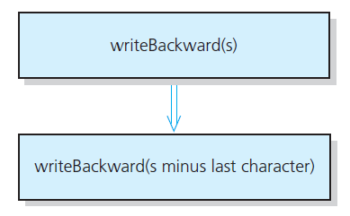
A Recursive Void Function: Writing a String Backward
Likely candidate for minor task is writing a single character.
Possible solution: strip away the last character
A recursive solution

Slide 31
A Recursive Void Function: Writing a String Backward
Tracing: Write BAT backwards
The initial call is made: s = “BAT”, length of s = 3 print T and write BA backwards
The next call: s = “BA”, length of s = 2 print A and write B backwards
The next call: s = “B”, length of s = 1 print B and write “” backwards
The next call: s = “”, length of s = 0 do nothing, since the string has no characters
Output
T
A
B
WriteBackwards.cpp

Slide 32
Search
Common problem in computing
Large data sets
Want to find specific information.

Slide 33
Searching Arrays
A sequential search is one way to search an array for a given value
Look at each element from first to last to see if the target value is equal to any of the array elements
The index of the target value can be returned to indicate where the value was found in the array
A value of -1 can be returned if the value was not found

Slide 34
Linear Search - Example
Array arr contains:
Searching for the the value 11.3, linear search examines 17.1, 23.2, 5.0, and 11.3
Searching for the the value 7, linear search examines 17.1, 23.2, 5.0, 11.3, 2.5, 29.4, and 3.8
17.1 | 23.2 | 5.0 | 11.3 | 2.5 | 29.4 | 3.8

Slide 35
The search Function
The search function
Uses a while loop to compare array elements to the target value
Sets a variable of type bool to true if the target value is found, ending the loop
Checks the boolean variable when the loop ends to see if the target value was found
Returns the index of the target value if found, otherwise returns -1

Slide 36
The search Function
int search(const double a[], int size, double target)
{
int index = 0;
bool found = false;
while ((!found) && (index < size)) {
if (target == a[index])
found = true;
else
index++;
}
if (found)
return index;
else
return -1;
}

Slide 37
Linear Search - Tradeoffs
Benefits:
Easy algorithm to understand
Array can be in any order
Disadvantages:
Inefficient (slow): for array of N elements, examines N/2 elements on average for value in array, N elements for value not in array

Slide 38
Binary Search
Requires array elements to be in order
Divides the array into three sections:
middle element
elements on one side of the middle element
elements on the other side of the middle element
If the middle element is the correct value, done. Otherwise, go to step 1. using only the half of the array that may contain the correct value.
Continue steps 1. and 2. until either the value is found or there are no more elements to examine

Slide 39
Binary Search - Example
Array ordered contains:
Searching for the value 11.3, binary search examines 11.3 and stops
Searching for the value 7.0, linear search examines 11.3, 3.8, 5.0, and stops
2.5 | 3.8 | 5.0 | 11.3 | 17.1 | 23.2 | 29.4

Slide 40
Iterative Binary Search
Set first index to 0.
Set last index to the last subscript in the array.
Set found to false.
Set position to -1.
While found is not true and first is less than or equal to last
Set middle to the subscript half-way between array[first] and array[last].
If array[middle] equals the desired value
Set found to true.
Set position to middle.
Else If array[middle] is greater than the desired value
Set last to middle - 1.
Else
Set first to middle + 1.
End If.
End While.
Return position.

Slide 41
A Binary Search Function
int binarySearch(double array[], int size, double target) { int first = 0, // First array element last = size - 1, // Last array element middle, // Mid point of search position = -1; // Position of search value bool found = false; // Flag while (!found && first <= last) { middle = (first + last) / 2; // Calculate mid point if (array[middle] == target) // If value is found at mid { found = true; position = middle; } else if (array[middle] > target) // If value is in lower half last = middle - 1; else first = middle + 1; // If value is in upper half } return position; }
Arrays/BinarySearch.cpp

Slide 42
Binary Search - Tradeoffs
Benefits:
Much more efficient than linear search. For example, if an array has 1000 elements, performs at most 10 comparisons, as opposed to 1000 for linear search
(For 1,000,000 elements, only 20 comparisons!)
Disadvantages:
Requires that array elements be sorted

Slide 43
Linear vs. Binary Search
Value more clear when you have lots of values
Suppose we have values ordered from smallest to largest.
Number of Integers | Linear Search Worst case number of elements examined | Binary Search Worst case number of elements examined
1,000,000,000 | 1,000,000,000 | 30
1,000,000,000,000,000,000,000 (1X10²¹) | 1X10²¹ | 70
1X10⁵⁰ | 1X10⁵⁰ | 166

Slide 44
Sort???
Use built in sort
#include <algorithm>
int values[100]; // load with values
Or write your own… (Coming soon)

Slide 45
A Recursive Binary Search Function

Slide 46
A Recursive Binary Search Function
Binary search algorithm can easily be written to use recursion
Base cases: desired value is found, or no more array elements to search
Algorithm (array in ascending order):
If middle element of array segment is desired value, then done
Else, if the middle element is too large, repeat binary search in first half of array segment
Else, if the middle element is too small, repeat binary search on the second half of array segment

Slide 47
A Recursive Binary Search Function (Continued)
int binarySearch(double array[], int first, int last, double target)
{
int middle; // Mid point of search
if (first > last)
return -1;
middle = (first + last)/2;
if (array[middle]==target)
return middle;
if (array[middle]<target)
return binarySearch(array, middle+1,last,target);
else
return binarySearch(array, first,middle-1,target);
}
BinarySearch.cpp

Slide 48
Recursion and Efficiency
Some recursive solutions are so inefficient that they should not be used
Factors that contribute to the inefficiency of some recursive solutions
Overhead associated with method calls
Inherent inefficiency of some recursive algorithms
Do not use a recursive solution if it is inefficient and there is a clear, efficient iterative solution

Slide 49
Recursive Algorithms
Recursive Fibonacci Evaluation:
f(4)
Note the redundant computations involved here, which leads to the conclusion that recursion in this case is not the most efficient way to compute the solution
f(3)
f(2)
f(2)
f(1)
f(1)
f(0)
f(1)
f(0)

Slide 50
unsigned fib(const unsigned n) {
if (n <= 1) {
return n;
}
else {
return fib(n-1) + fib(n-2);
}
}
unsigned fib(const unsigned n) {
unsigned f;
if (n <= 1) {
return n;
}
else {
unsigned f2 = 0, f1 = 1;
for (unsigned i = 2; i <= n; i++) {
f = f1 + f2;
f2 = f1;
f1 = f;
}
return f;
}
}

Slide 51
The Towers of Hanoi
Notes:
Start 4:10 and 5:45 classes here

Slide 52
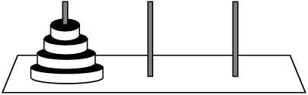
The Towers of Hanoi
The Towers of Hanoi is a mathematical game that is often used to demonstrate the power of recursion.
The game uses three pegs and a set of discs, stacked on one of the pegs.

Slide 54
The Towers of Hanoi
The objective of the puzzle is to move the entire stack to another rod, obeying the following simple rules:
Only one disk can be moved at a time.
Each move consists of taking the upper disk from one of the stacks and placing it on top of another stack or on an empty rod.
No larger disk may be placed on top of a smaller disk.
All discs must be stored on a peg except while being moved.

Slide 55
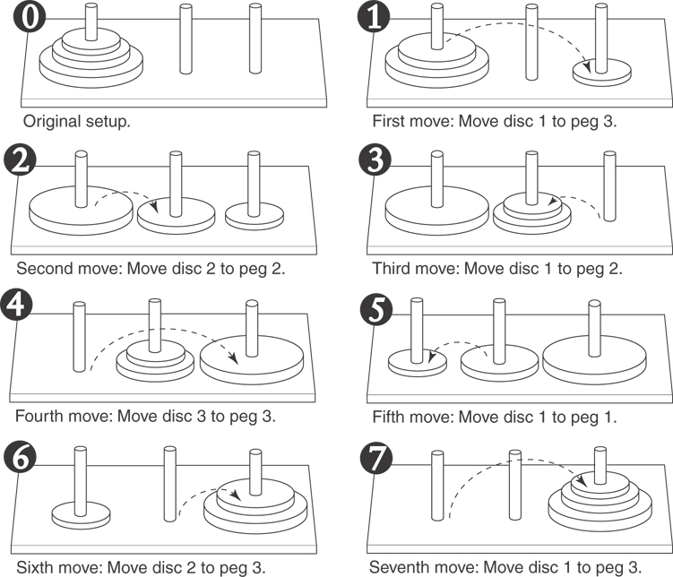
Solving with Three Discs
Image source: Tony Gaddis, Starting out with Java

Slide 56
The Towers of Hanoi
The following statement describes the overall solution to the problem:
Move n discs from peg 1 to peg 3 using peg 2 as a temporary peg.

Slide 57
The Towers of Hanoi
Algorithm
To move n discs from peg A to peg C, using peg B as a temporary peg: If n > 0 Then Move n – 1 discs from peg A to peg B, using peg C as a temporary peg. Move the remaining disc from the peg A to peg C. Move n – 1 discs from peg B to peg C, using peg A as a temporary peg. End If
Hanoi.cpp
Hanoi2.cpp

Slide 58
Quick-Sort
6 4 9 7 2 → 4 2 6 7 9
4 2 → 2 4
7 9 → 7 9
2 → 2
9 → 9
Notes:
Start 3:00 class here Friday

Slide 59
Quick Sort
AKA “partition-exchange” sort
First developed by C.A.R Hoare c. 1960
Like binary search, it is a “divide-and-conquer” algorithm
It partitions an array into items that are
Less than or equal to the pivot and
Those that are greater than or equal to the pivot
Partitioning places pivot in its correct position within the array
Then the two “halves” are sorted (using quicksort)

Slide 60
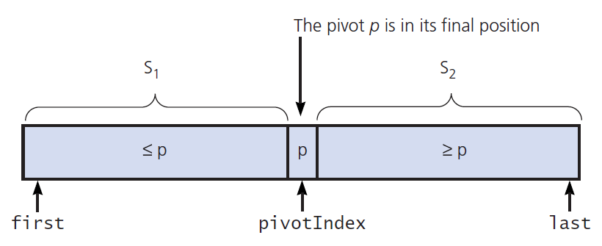
Quick Sort
The important part of Quicksort is how to perform the partitioning step
A partition around a pivot

Slide 61
First draft of pseudocode for the quick sort algorithm
The algorithm is coded primarily in two functions: quickSort and partition. quickSort is a recursive function. quickSort:
IF Starting Index < Ending Index
Partition the List around a Pivot.
quickSort Sublist 1.
quickSort Sublist 2.
ENDIF

Slide 62
Here is the C++ code for the quickSort function:
void quickSort(int set[], int start, int end)
{
int pivotPoint;
if (start < end)
{
// Get the pivot point.
pivotPoint = partition(set, start, end);
// Sort the first sublist.
quickSort(set, start, pivotPoint − 1);
// Sort the second sublist.
quickSort(set, pivotPoint + 1, end);
}
}

Slide 63
Pseudocode for Lomuto’s Partitioning algorithm
partition(set[], first, last)
mid = └first + last)/2┘ swap set[first] with set[mid]
pivot = set[first]
s = first // place for swapping
for j := first +1 to last do
if set[j] < pivot then
s = s + 1
swap set[s] with set[j] endif
endfor
swap set[s] with set[lo]
return s end partition

Slide 64
Partitioning Example
83 52 24 65 17 35 96 42
65|52 24 83 17 35 96 42 - swap 1st with midpoint
65 52 24 17|83 35 96 42 - scan until one is less than pivot, then swap with dividing element
65 52 24 17 35|83 96 42 - scan until one is less than pivot, then swap with dividing element
65 52 24 17 35 42|96 83
42 52 24 17 35|65|96 83 - at end, put pivot in proper place

Slide 65
Partitioning
As mentioned, the hard part of quicksort is the partitioning of the array.
There are several ways to do this.
The Zybook uses a slight variation of Tony Hoare’s original partitioning technique.
Nico Lomuto’s partitioning technique is easier to implement
It requires more element moves, but fewer comparisons than Hoare’s

Slide 66
Partitioning Example (Tony Hoare)
65 52 24 83 17 35 96 42
> <
65 52 24 42 17 35 96 83
< >
35 52 24 42 17 65 96 83
Partitioning element
Stop when you find a number on the “wrong side” of the partition
Partitioning element now in its proper place
Notes:
Show Tony Hoare’s partitioning method here

Slide 67
Partitioning Example
3 5 7 11 13 17 19 23 29
< >
3 5 7 11 13 17 19 23 29
Partitioning element now in its proper place
Giving Quicksort an array already sorted is actually the worst case scenario unless you take some action to avoid it!
Notes:
Show Tony Hoare’s partitioning method here

Slide 68
The [Recursive] Merge Sort
To sort a list:
Divide list in half
Recursively sort the left half
Recursively sort the right half
Merge the sorted halves into a single sorted list
Notes:
So simple! So elegant!
Of course you can do mergesort iteratively, but WHY!?

Slide 69
procedure mergesort(A = a₁,…,a_{n}) if n > 1 then m = floor(n/2) L = a₁,…,a_{m} R = a_{m+1},…,a_{n} mergesort(L) mergesort(R) A = merge(L,R) endif end mergsort
Notes:
Isn’t it BEAUTFUL!?
The efficiency of mergesort depends on having an efficient algorithm for merging to sorted lists

Slide 70
procedure merge(L,R: sorted lists) A = empty list while L and R are both non-empty l,r = first element of L,R if l < r then remove l from L append l to A else remove r from R append r to A endif endwhile remove and append to A all elements of L,R return A // the merged list
Notes:
Worst case for merging two sorted lists with m and n elements is m+n-1 comparisons.
Can do better, e.g. if m=1, binary search through n elements takes log n compares.
(but still have to do m+n assigns)

Slide 71
Iteration & Looping
Recursion is a type of iteration!
Generally, anything that is written recursively can be converted into a loop. Sometimes, the looping version is more efficient, sometimes not.
Factorial is more efficient as a loop.
Merge sort is too complicated to write as a loop.

Slide 72
Final Thoughts
Why use Recursion?
It looks more like the real problem (e.g. Fibonacci numbers).
Frequently easier to implement that iterative version.
Every time you call a function there is overhead. Creating stack frame, saving address to return to, etc.
More useful applications of recursion in the data structures course.
Tree and graph traversals, etc.
However, we want you to have some exposure now. Then you won’t have to learn recursion and tackle a harder problem at the same time.

